Slide 1

A Minimal Metabolic Model of Energy-Driven
Dormancy in E. coli
George-David Apostolidis, Aadreeta Biswas and Jeroen Mieras
Modelling in Systems Biology

Slide 2
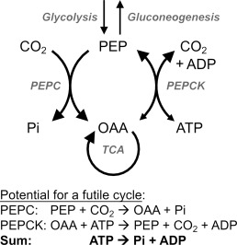
Background
Notes:
In particular, the core metabolic pathway described in the papers that were introduced to us consists of the uptake of Glucose by E. coli to start metabolism via the glycolysis and pentose phosphate pathways.
From the metabolites in the upper glycolysis pathway, phosphoenolpyruvate (PEP), pyruvate (PYR) and oxaloacetate (OAA) are produced to control the TCA cycle, and cell growth. These conversions depend on the cell’s energy status that is often considered as the ratio of available adenosine tri-phosphate (ATP) and adenosine di-phosphate (ADP)
The general direction of our research is to uncover what is required for dormant cells to start growing. We will use PEP concentration as a read-out for cell growth rates

Slide 3
How can we use the data to estimate the reaction rates and key parameters of our metabolic model focusing on the PEP-PYR node?
Notes:
Before we can analyze dormancy and growth, we first need a model whose behaviour matches the experimental data. We have time-series measurements of PEP and PYR of three different values of r (reaction scaling factor), which represent different growth conditions. Using these datasets, we estimate the key parameters of our simplified system, mainly the degradation rate d, the energy baseline phi0
We simulate the model with a candidate set of parameters, we compare the simulated PEP and PYR trajectories to the experimental curves, and we adjust the parameters until the mismatch is minimised.
Once we have reliable parameters, we can confidently use the model to explore when cells remain dormant and when they start growing.

Slide 4
Under which conditions does the simplified 2-equation model predict that E. coli cells remain dormant or transition into active growth?
Notes:
Our simplified 2-equation model lets us explore when cells stay dormant or switch to growth.
The key idea is that PEP acts as a proxy for growth: low PEP corresponds to dormancy, while rising PEP indicates growth initiation.
By analysing the interactions between PEP and PYR under different energy conditions, the model allows us to predict the boundary between these two states.

Slide 5
Can the simplified model reproduce the ability of dormant cells to resume growth under low-energy conditions?
If not, what minimal modifications to the model allow dormant cells to “wake up”?
Notes:
A key question in this project is whether a minimal PEP–PYR model can capture an essential biological behaviour: the ability of dormant cells to ‘wake up’ even when energy levels are low.
With this simplified system, we can test whether the built-in feedbacks are enough to trigger a rise in PEP or whether the model gets stuck in a dormant state.
If the basic structure cannot produce recovery, we can then explore the smallest possible changes, like adding a weak positive feedback or modifying how energy is represented, to see what mechanisms might enable a transition back to growth.

Slide 6
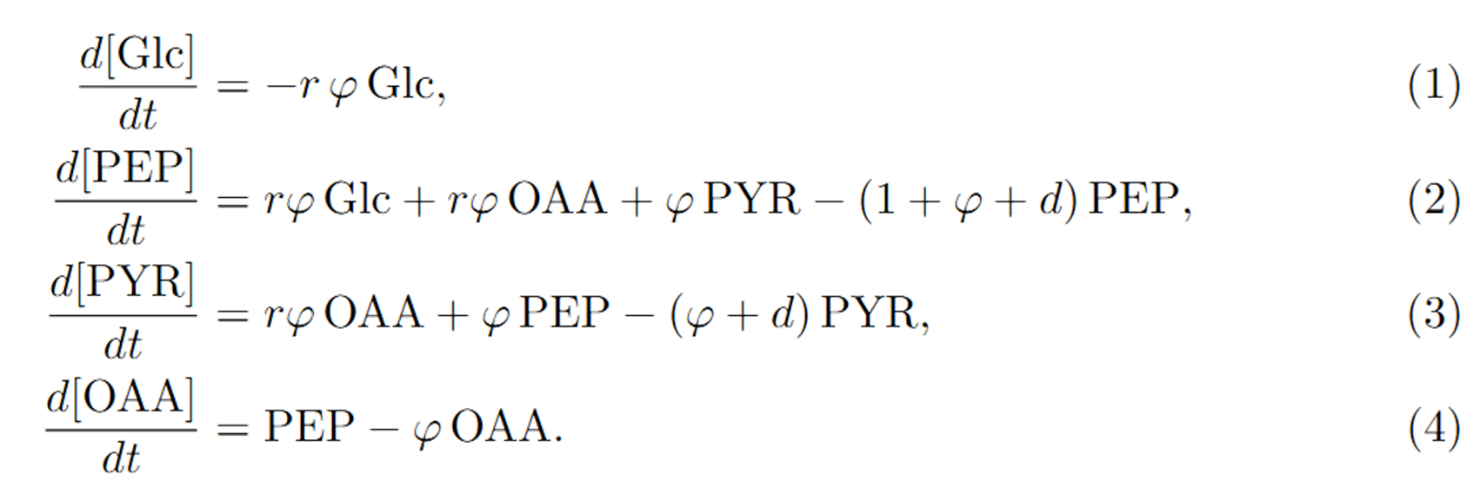

Notes:
Based on the provided reactions in the project description, we created the model presented here. Important to mention is that the amount of glucose fed to the cells is fixed at 1 microMole. Therefore, we assume the change in glucose to be zero in the further analyses.
Furthermore:
r = scaling factor related to the growth rate of E. coli cells
d = metabolite degradation rate
phi = parameter that corresponds to the energy status of the cells
This phi is related to the amount of PYR available, and phi0, so the total amount of ATP/ADP available.
PEP concentration is considered a proxy for cell growth rates, so when PEP is present, the cell will grow.

Slide 7
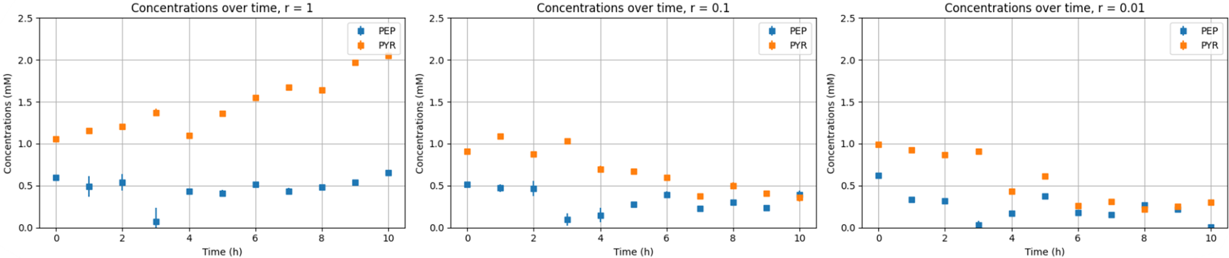
Notes:
This is the data we had. You can see the PEP and PYR concentrations (in microMole) over time, in which time is expressed in hours and it ranges from 0 to 10 hours.

Slide 8
N = 2000 parameter sets for random values (between selected bounds) of
OAA(0), d, and φ0
Select lowest scoring parameter set
Optimisation
Select lowest scoring parameter set
Notes:
We used the model, the provided data, and a scoring function to estimate the parameters. This scoring function was a slightly adjusted version of the one we used in the practical in Week 5. To be clear, the parameters we have estimated are: 1 the initial condition of OAA, 2 degradation rate d, and 3 phi0.
We used Latin Hypercube Sampling to get values for the parameters predefined bounds, and consequently created 2,000 parameter sets. We calculated the scores and selected the lowest scoring parameter set. After this, we created a narrower search grid around these values and did and, again, picked the lowest scoring parameter set. In other words, the parameters that best fit the data.

Slide 9
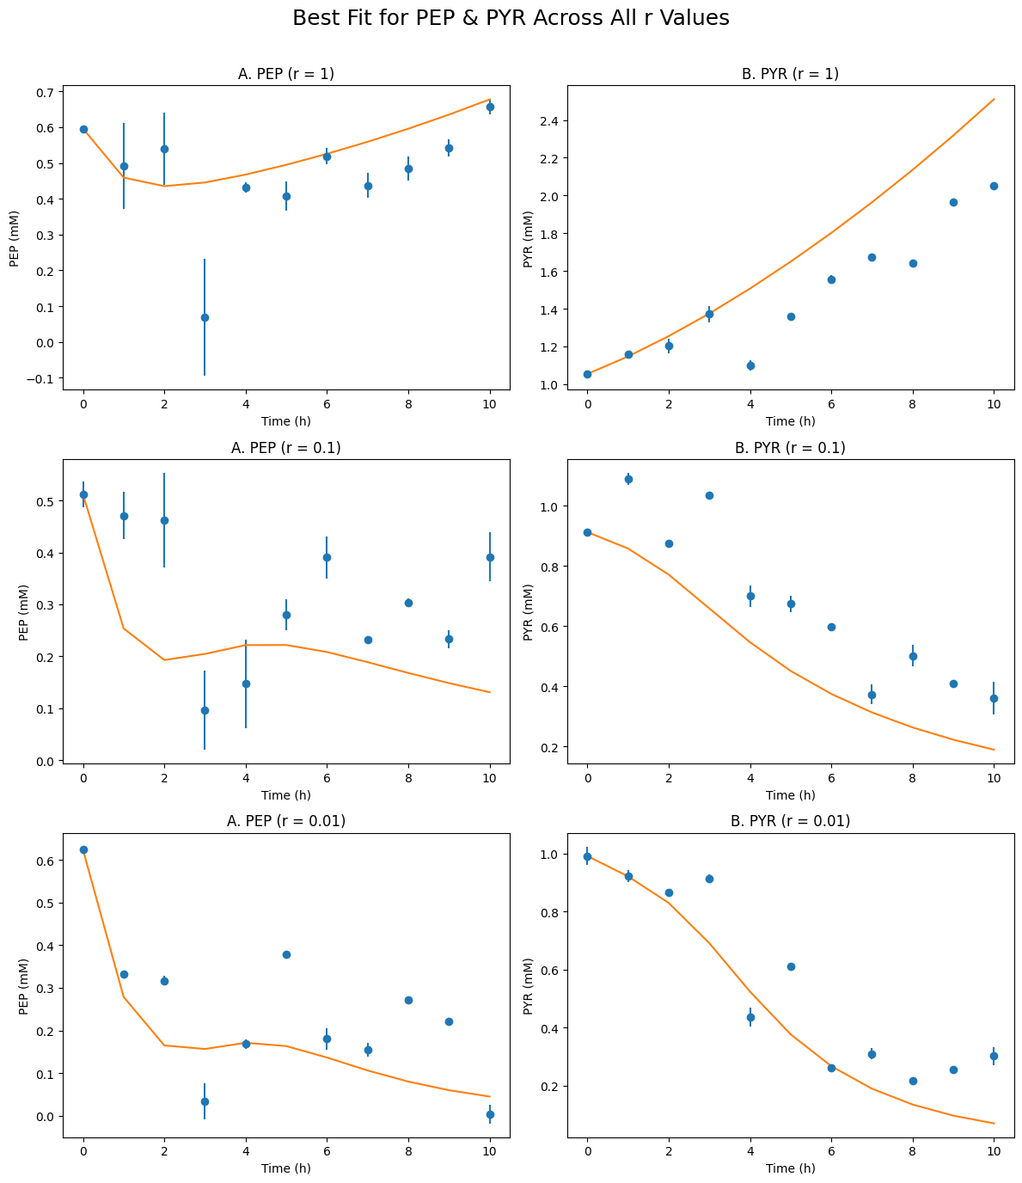
Notes:
Using these parameters we simulated the model and got these results.

Slide 10
Glc remains constant, → 0
Notes:
Now we have the parameter values, we have to simplify the model to two equations. I already mentioned that we assume the change in glucose to be 0.

Slide 11
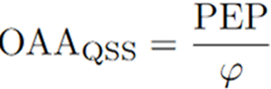
QSS assumption, = 0 →
Notes:
We also make another assumption to get rid of the ODE for OAA, which is a quasi-steady-state assumption for OAA. Thus, this only applies if the timescale at which OAA changes is much faster than the changes in PEP and PYR.

Slide 12
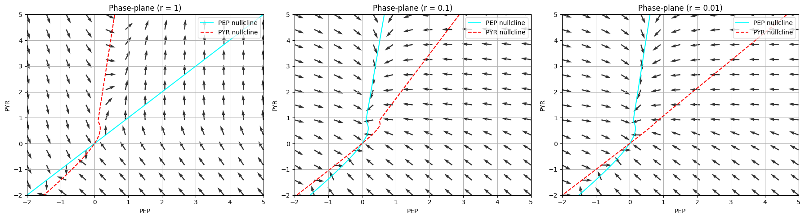
Notes:
Now we have the simplified model, we looked at the phase plane of the model. As you can see, the behaviour of the system is different for the different r values. This is because the eigenvalues change based on this parameter.
We can see that, for r = 0.01 and 0.1, there is only 1 stable steady state, so an attractor.
However, for r = 1, the stable steady state turned into an unstable steady state, a saddle point. Now, if either PEP or PYR is present, or both, the PEP and PYR values keep increasing. This is what we assumed to be a growing state instead of the dormant state for r = 0.1 and 0.01.

Slide 13
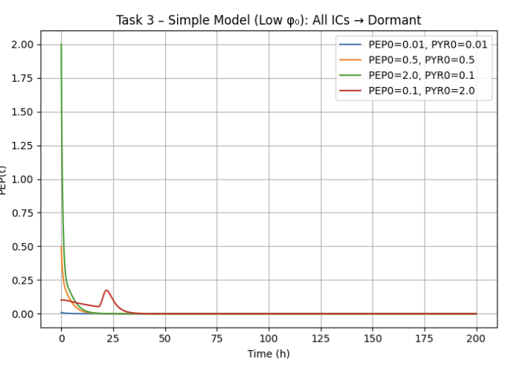
Checking for low energy values
Notes:
we first simulated the model at a low ATP/ADP baseline (φ₀ = 0.05) using four distinct initial metabolite states representing dormant, moderate, and perturbed metabolic conditions.
Go to next slide and explain that
The resulting trajectories showed that all simulations, regardless of how much PEP or PYR was present initially, converged to the same extremely low PEP steady state. Some conditions displayed a brief transient increase in PEP, but all ultimately collapsed to a shared equilibrium close to zero. This behaviour indicates that the model contains only a single globally stable attractor under low-energy conditions

Slide 14
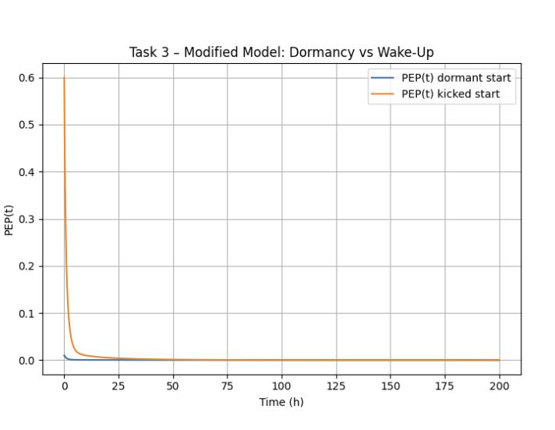

Notes:
Why michaelis -menten
We adopted a Michaelis–Menten–type expression because, mathematically, it
responds smoothly to small changes in PEP while preventing unrealistically sharp
increases in φ and provides parameters (α and K) which are needed to test whether metabolic feedback can produce bistability. A simple linear function would cause φ to rise too quickly with PEP,
which is not biologically plausible. To examine whether a switch out of dormancy could
occur at low energy availability, we therefore introduced the modified feedback form
Showing the equation we are gonna explain it.
Here α determines how strongly PEP improves the energy status, while K defines the
PEP concentration required for half-maximal enhancement.
Simulations were carried out from both a deeply dormant state and a “kicked” state with elevated initial PEP. Contrary to expectation, both trajectories decayed to the same low-PEP equilibrium, and no separation between dormant and activated outcomes was observed. This demonstrates that the chosen feedback parameters (α = 0.8, K = 0.5) were too weak to produce bistability, as φ(P) increased only minimally and was insufficient to overcome the low φ₀ baseline.
Therefore, even with feedback, the simplified model remains monostable and does not permit wake-up from dormancy.

Slide 15
Discussion Points

Slide 16
Discussion Points
Optimising model for wide range of parameters
Notes:
We tested 2,000 parameter sets and selected the best-scoring one, but this optimisation may have landed on a local rather than a global optimum. Other untested combinations might fit the data better. This is important because the simplified model is sensitive to parameter choice, so downstream results should be interpreted with this limitation in mind.
We need to check for a wide range of parameters.

Slide 17
Discussion Points
Optimising model for wide range of parameters
Examining data with different glucose uptake levels
Notes:
The three glucose uptake levels (r = 1, 0.1, 0.01) show that the system changes a lot depending on how much nutrient is available. Increasing the scaling factor r improved the model’s behaviour at low energy, showing that cells cannot escape dormancy without sufficient nutrient influx. This supports the idea that E. coli must first rebuild ATP and restart central metabolism before transitioning from lag phase to exponential growth, with higher r values better capturing this behaviour.

Slide 18
Discussion Points
Optimising model for wide range of parameters
Examining data with different glucose uptake levels
Reintroducing OAA or other considered constant metabolites
Notes:
We also studied how the system behaves at low energy levels. In theory, cells can either stay dormant or switch into growth, but our simplified model showed only one outcome: all initial conditions collapsed into the same low-PEP dormant state. Even after adding feedback through α and K, we still found no evidence of bistability.
This agrees with real E. coli, which often enters a low-metabolism dormant state under stress and becomes more tolerant to antibiotics. Our results show that the 2-equation model is monostable and cannot reproduce wake-up behaviour. To achieve this, we would likely need to reintroduce additional metabolites, such as OAA, or include more complex regulatory loops from the full Himeoka & Mitarai model

Slide 19
Thank you!
Questions?

